Slide 1
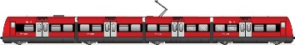
Introduction to SORTEDMOBILITY
RAILcph 2023
Fabrizio Cerreto
Rail Traffic Analyst, Capacity Development, Banedanmark
22/05/2023

Slide 2


Concept
Project consortium
Case studies
  France
  Italy
  Denmark

Slide 3
SORTEDMOBILITY: The concept

Slide 4
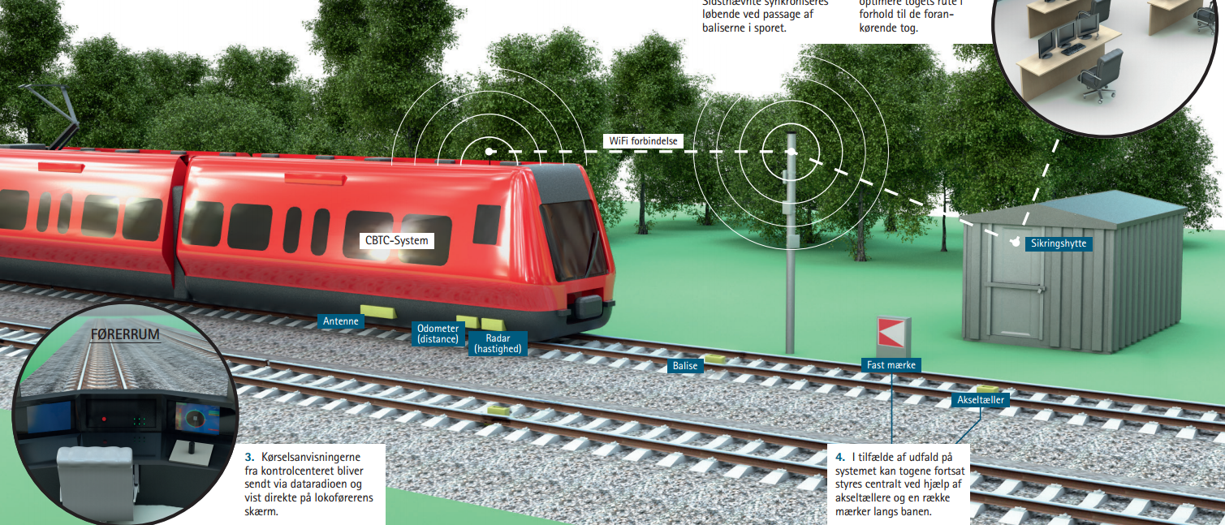
CBTC and driverless s-trains

Slide 5
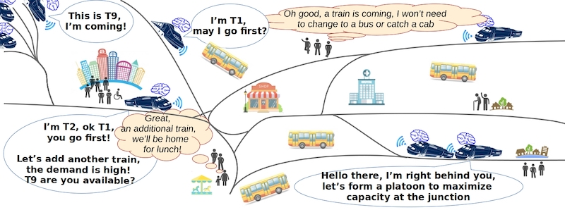
Self-Organized Rail Traffic for the Evolution of Decentralized MOBILITY
“Intelligent trains will operate in a self-organized manner to guarantee high levels of service in the multi-modal public transport context.”

Slide 6
Expected benefits of self-organized and decentralized rail traffic
Self-adaptation - Responsiveness
Resilience (daily perturbations/ major disruptions)
Economy (Flexibility of operations under reduced demand)
Multimodal integration

Slide 7


Questions
Which trains will be negotiating: who talks to whom?
What is the negotiation criteria: what is the objective?
Is there any benefit in decentrilized traffic management?
What could the challenges be?
Does this make sense at all?
In what circumstances?

Slide 8

Out of scope
Train communication
Virtual Coupling

Slide 9
Project consortium

Slide 10
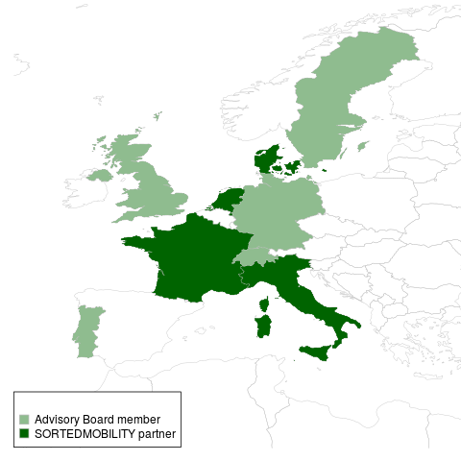








Project members
Research institutes
Université Gustave Eiffel (F)
Danmarks Tekniske Universitet (DK)
Istituto di Scienze e Tecnologie della Cognizione (I)
Delft University of Technology (NL)
Industrial partners
SNCF (F)
Banedanmark (DK)
Rete Ferroviaria Italiana (I)

Slide 11
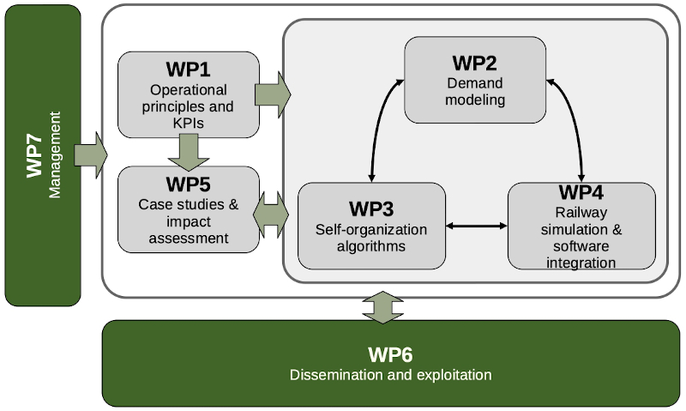


Project structure
WP1 | Operational principles and KPI
WP2 | Demand modeling
WP3 | Self-organization algorithms
WP4 | Railway simulation
WP5 | Case studies
WP6 | Dissemination and Exploitation
WP7 | Management

Slide 12


Timeline and status
Project started in June 2021
Project due in May 2024
 | Operational principles and KPI
 | Demand modeling
 | Self-organization algorithms
 | Railway simulation
 | Case studies

Slide 13
Case studies

Slide 14
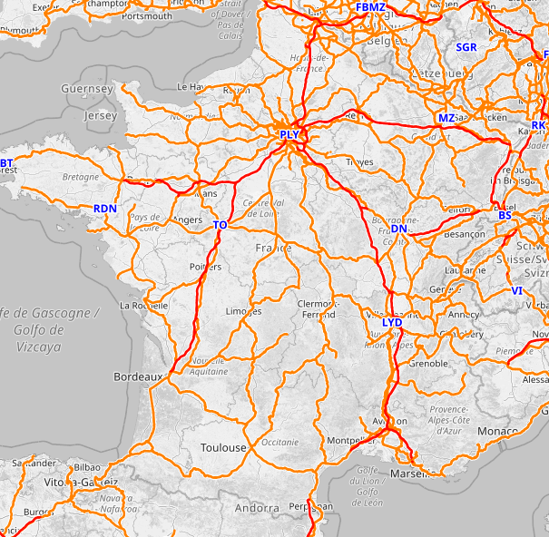
France
Guingamp – Paimpol

Slide 15
France
Guingamp – Paimpol
Single track
Low traffic volume
Local traffic

Slide 16

1. Initial situation: two trains arriving at the Pontrieux station
Paimpol
Pontrieux
1
2
3
4
5
Guingamp
Paimpol
2. Uncoupling of the trains
Pontrieux
1
2
3
4
5
Guingamp
Paimpol
3. Train recomposition
Pontrieux
2
3
Guingamp
1
4
5
Paimpol
4. Two ‘new’ trains can now proceed
Pontrieux
2
3
Guingamp
1
4
5

Slide 17
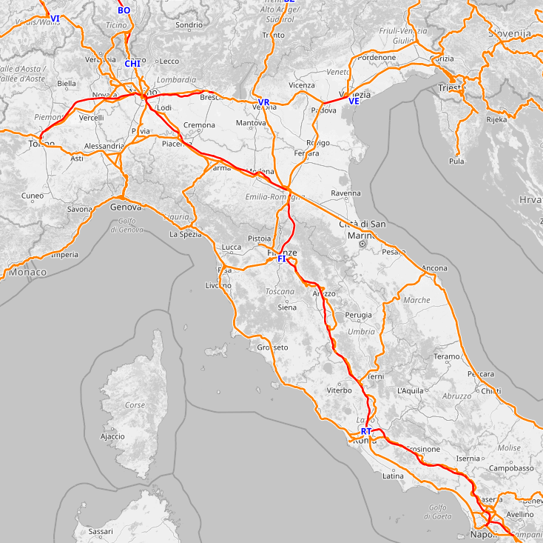
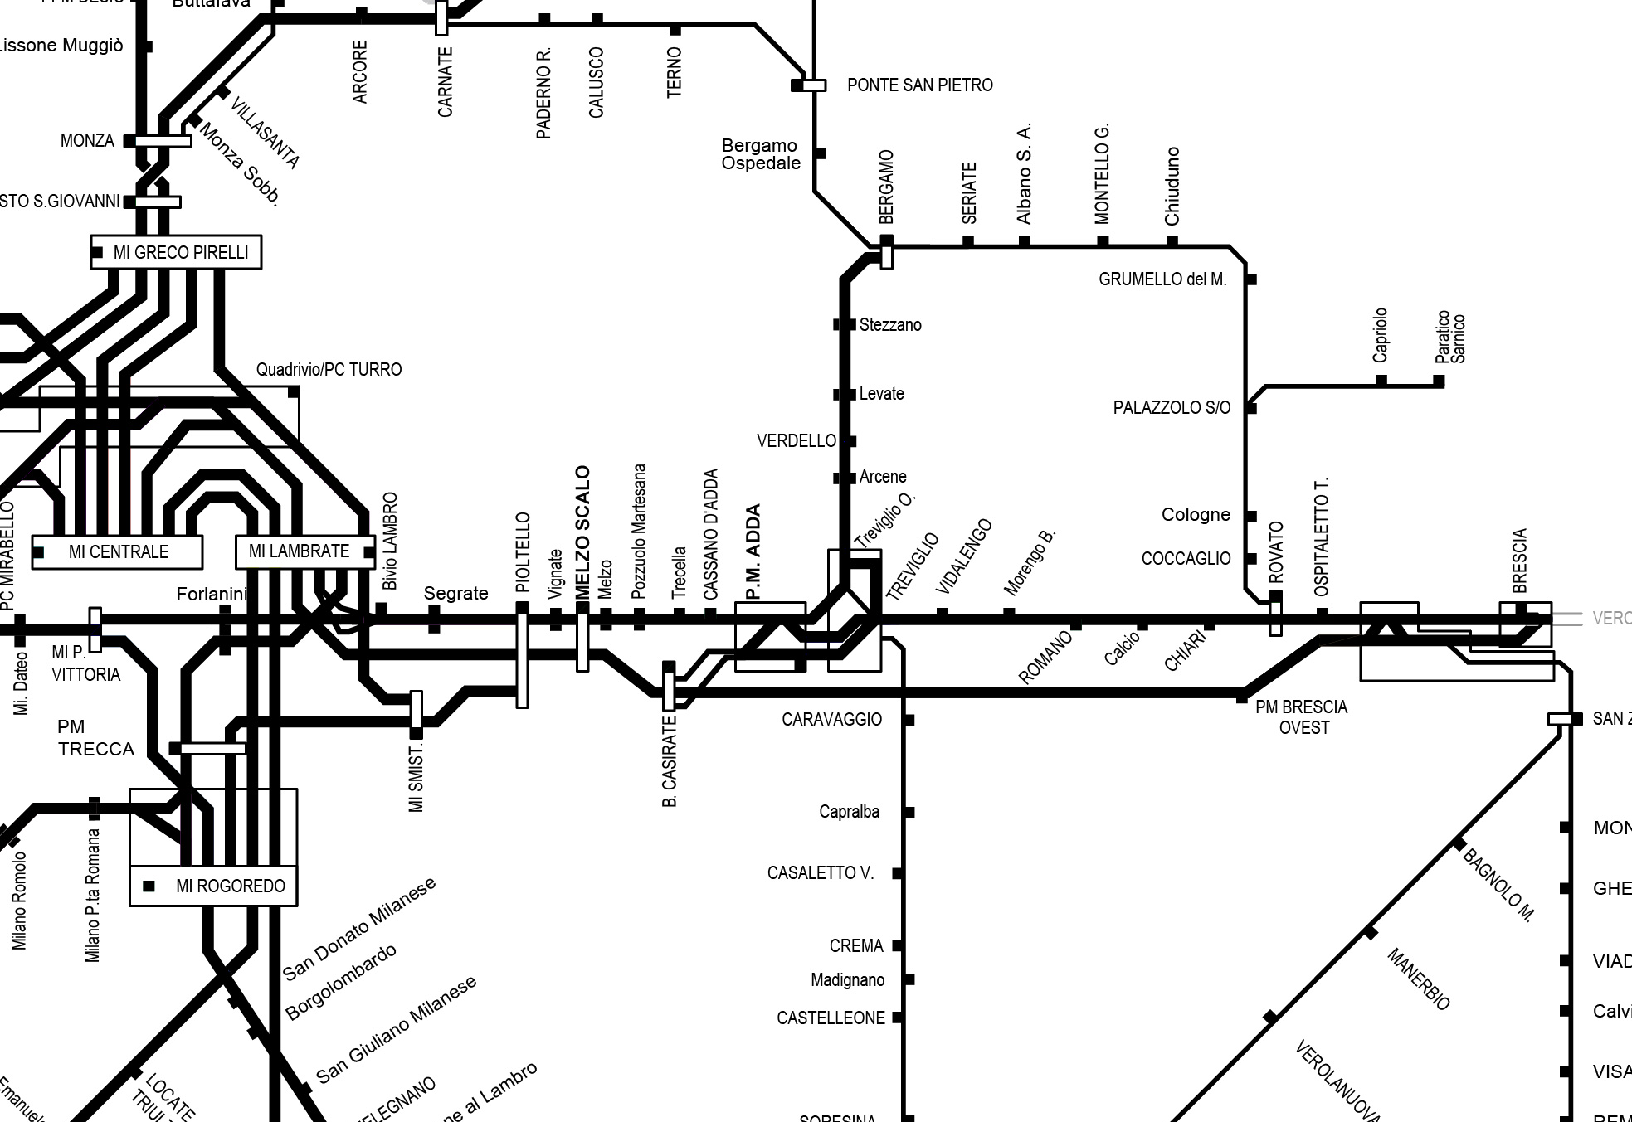
Italy
Pioltello – Rovato
Mixed line
Several interfaces
Partial implementation

Slide 18
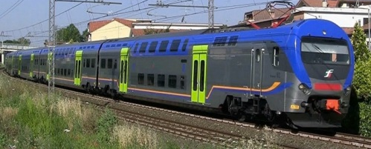
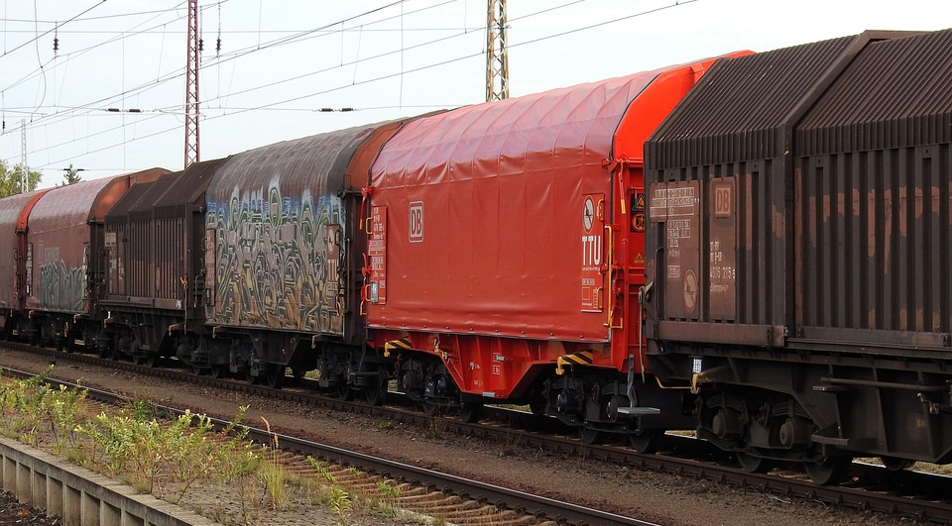
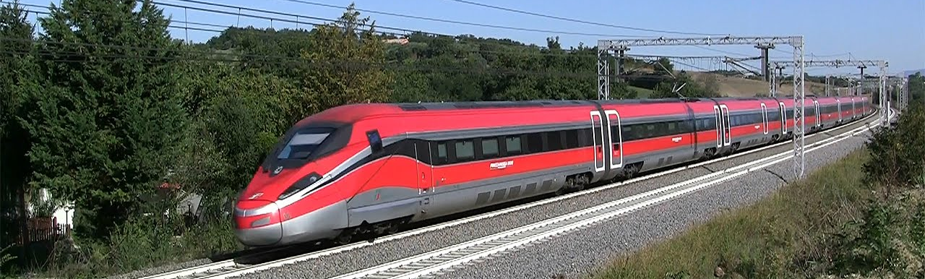
Italy
KEY:
Regional
Long Haul
Pioltello – Rovato
18

Slide 19
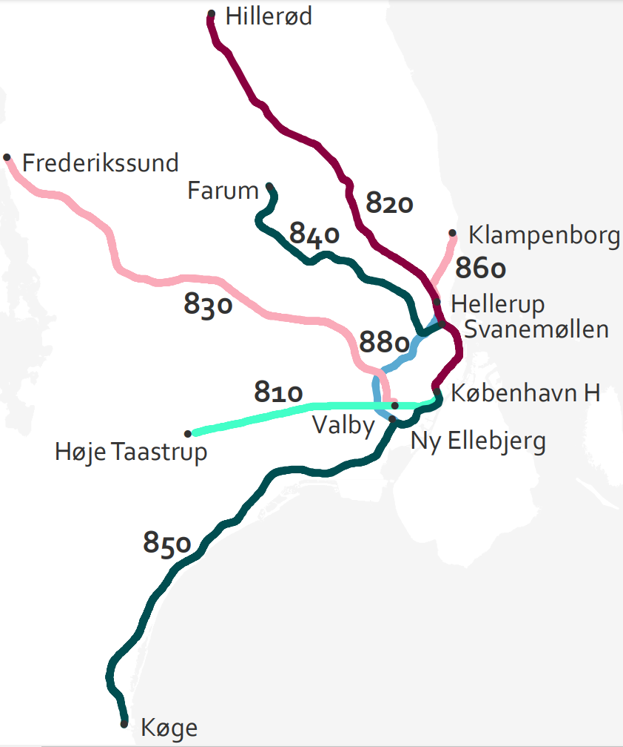
Copenhagen S-bane
Suitable network structure
  Starshaped
  High density
  CBTC – driverless rolling stock
  Confined environment
High data availability
  Traffic realization data
  Microsimulation models
  Rejsekort
  DMI
  Other
  Willingness to share data

Slide 20
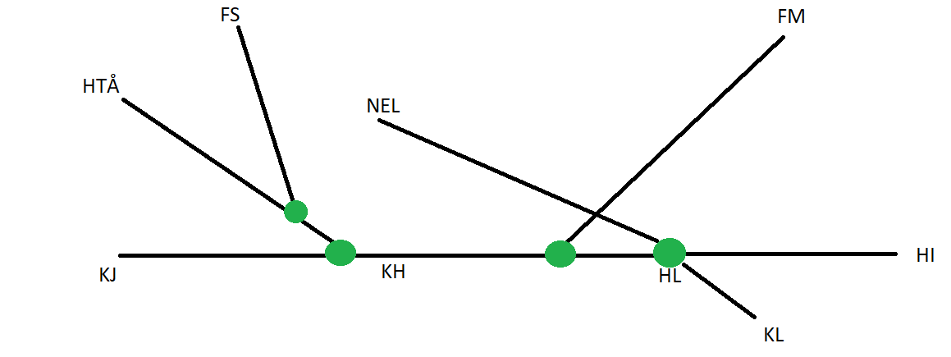
Examples of decisions unfer self-organized traffic
Skip-stop
Platooning
Combination of fingers
Short-turning
Optimization of capacity utilization Dybbølsbro - Svanemøllen

Slide 21
Exploring further: The Expres tunnel
Infrastructure simulation model ready
Adds:
  Possible decisions for trains
  Challenges for passenger demand

Slide 22


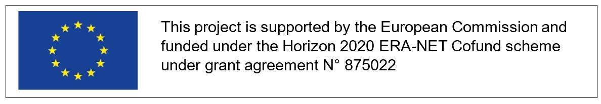
For questions and comments:
fceo@bane.dk

